Slide 1
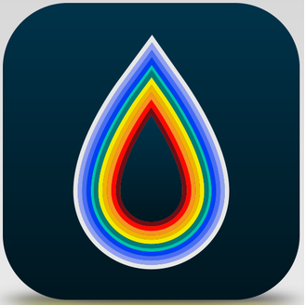
Climate Forecasting
Supervisor: Dr. Timothy Roden
Presented by:
Nidhi Patel
L20410813

Slide 2
OutLine
Introduction
Required Software
Implementation
Related Work
Conclusion
Reference

Slide 3
Introduction
Weather forecasting is more than fortune-teller.
My project is based on android.
An overview screen displaying the weather condition for today.
In this app user can add their location to the front page.
This app don’t have minimum OS version requirement. So, it will work in any android version.

Slide 4
Required Software
Android Studio 2.2.5
Android version 4.4 and Higher version
Minimum SDK version for android: 19
API: Openweather map

Slide 5
Development
Android Studio: Android Studio is the official integrated development environment (IDE) for the Android platform.
I have used java as a programming language.
Concurrent
Class-based
Object Oriented
JSON(JavaScript Object Notation) is a data-interchange format.
Openweather map provides weather data and its open source.

Slide 6
Development
Three Java files
Around 990 lines in code
Database file for weather
Three images

Slide 7


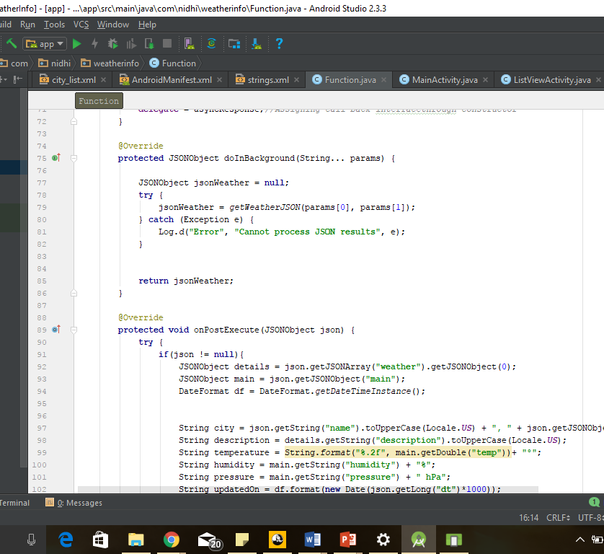
Development
JSON (JavaScript object notation)
Representing structured data as JavaScript objects.
Independent data exchange format.
Best alternative for xml.

Slide 8
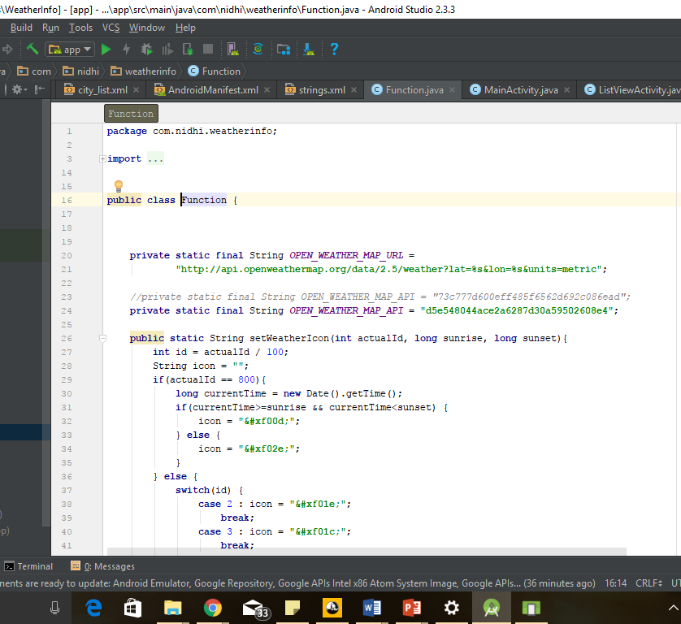
Development
Openweather map:
Its open source and online service
It provides current weather data, forecasting historical data to developers.
Openweather map API utilize broadcast services, raw data from radar station.

Slide 9
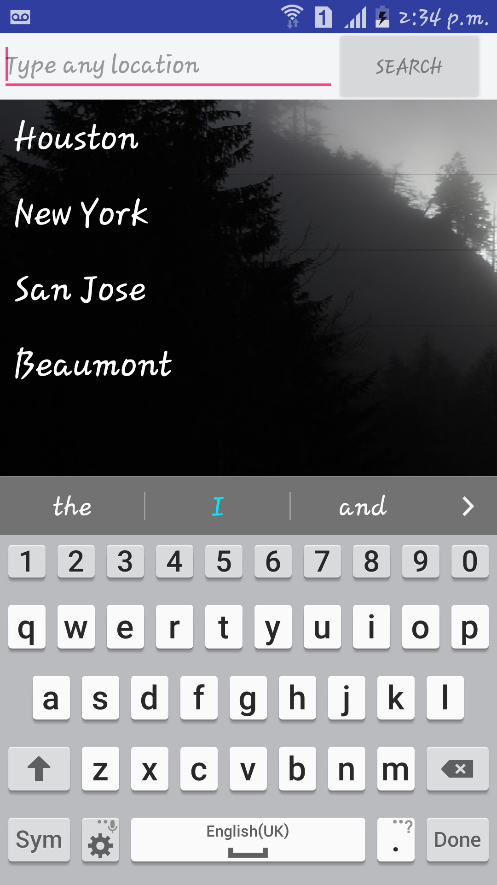
Implementation
List of android activities
List view of cities
Main activity/main page

Slide 10

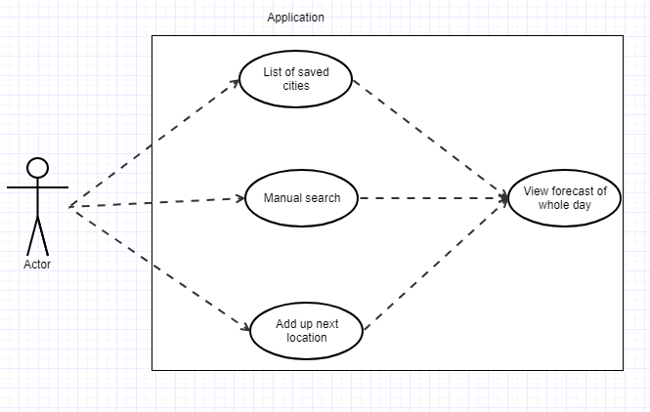
Workflow of the application

Slide 11
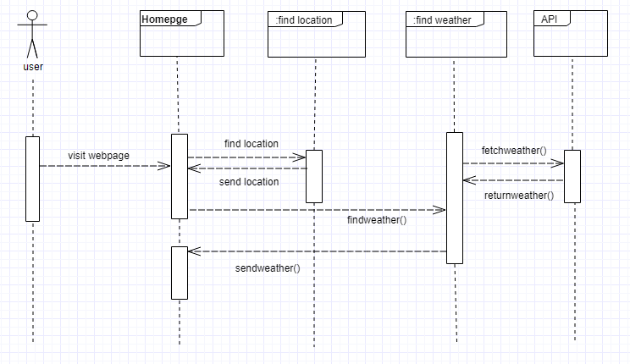
UML Sequence Diagram
When users visit first time application.

Slide 12
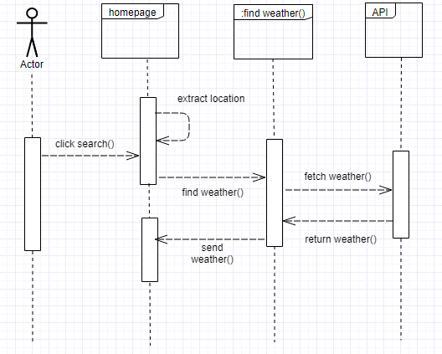
UML Sequence Diagram
When user manually search city name and see weather information.

Slide 13
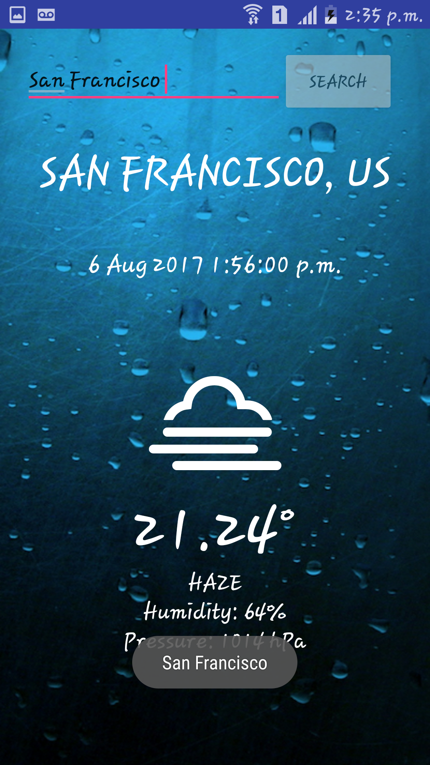

Screenshots

Slide 14
Problem Faced
Main problem I faced was implementation of Openweathermap API.
Fetching server data
In my project, I played the role of both, the users and developer, and my adaption requirement changes was most important challenge.

Slide 15
Future Scope
Planning to do notification for Climate.
Offline Application.
Thinking to add Language preference. So, in any language user can use application

Slide 16
Conclusion
The main reason to create this application is user can see climate and stay informed with accurate forecasts, interactive radar and real time rain alert.
And free mobile application with less storage size.
To making this I learned so many new techniques and programming style.

Slide 17
References
Openweather Map API: https://home.openweathermap.org/api_keys
Phillips, Bill, and Brian Hardy. Android programming: The Big Nerd Ranch guide. Atlanta, GA: Big Nerd Ranch, 2015.
For Android Developers: https://developer.android.com/index.html
Weather icons: https://github.com/erikflowers/weather-icons/blob/master/font/weathericons-regular-webfont.ttf

Slide 18


